Slide 1

Emergency Management for Law Enforcement Executives
Minnesota Chiefs of Police
CLEO Academy
2015

Slide 2

Objectives
Overview of Emergency Management and NIMS
Understand importance of emergency management in law enforcement
Review Incident Command System
Application of ICS for the LE executive

Slide 3
Minneapolis Responds-The 35W Bridge Collapse

Slide 4

Why is Emergency Management Important?
Bad stuff happens.
Day to day methods of conducting operations do not work well in responding to large scale emergencies.
Our agencies are divided up into logical divisions.
These divisions don’t always work well in the crisis environment of an emergency.
Oversight or checks & balances disappear quickly in a rapidly moving, unfolding crisis.
Eventually somebody steps up and says “I’m in charge!”
You will only be as successful as the skills you possess in your “Emergency Management Toolbox.

Slide 5
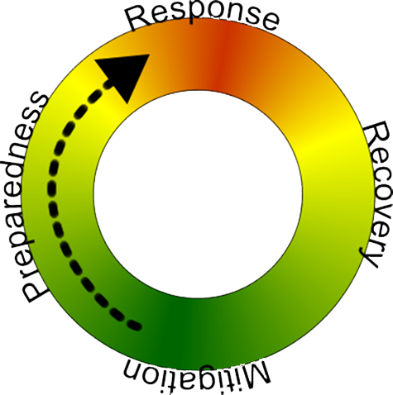
Why is Emergency Management Important?
Conduct an analysis of the potential hazards & threats.
  Consult emergency manager and fire department.
You mitigate through:
  understanding the potential threats.
  plans to reduce the threat and prepare for response.
  training your people.
Everyone in your organization needs to understand their role as well as the plan.
Test the plan!

Slide 6
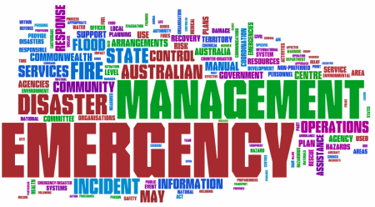
A Comprehensive Emergency Management Plan…
Examines potential emergencies based on risk.
Develops and implements programs to reduce the impact of those events.
Prepares you for those risks that can’t be eliminated and prescribes the actions to deal with and recover from them.

Slide 7
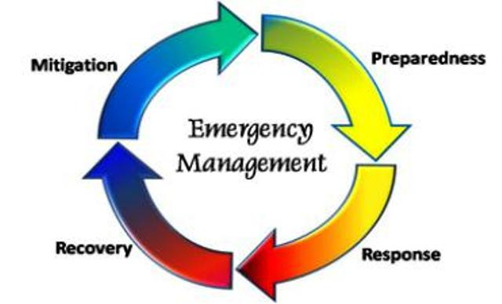
Mitigation, Preparedness, Response, Recovery
Mitigation-taking sustained actions to reduce or eliminate risk to people and property from hazards and their effects.
Preparedness-developing the emergency management function to respond and recover from any hazard.
Response-conducting emergency operations to save lives and property as well as restoring critical services.
Recovery-rebuilding to restore normal life and operations.

Slide 8
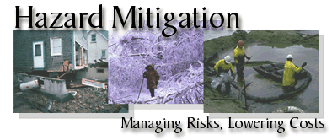
Mitigation
Goals:
Protect people and structure.
Reduce the costs of response and recovery.

Slide 9

Mitigation
Accomplished through a hazard analysis that helps to identify:
What events can occur in and around your community.
The likelihood an event will occur.
The consequences of the event in terms of…
  Casualties
  Destruction
  Disruption to critical services
  Costs of recovery

Slide 10
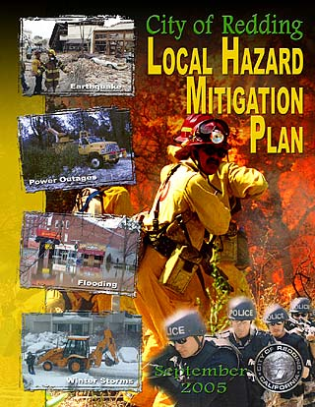
Mitigation Strategy
Must consider the hazards faced.
The potential for damage from those hazards.
Overall needs and capacity of your agency.

Slide 11

Exercise
Select one member from your group.
What is the hazard for which your community is at highest risk?
What type(s) of damage is/are likely to occur?
What steps can be taken to reduce damage from this hazard?
How will you know if your mitigation efforts are successful?
You should be able to answer each of these questions for each specific hazard in your community.

Slide 12

Preparedness
Includes plans or other preparations made to save lives and facilitate response and recovery operations.
  Development of an Emergency Operations Plan (EOP).
  Recruiting, assigning, training staff.
  Identifying resources and supplies in advance.
  Designating facilities for emergency use (EOC).

Slide 13

Preparedness
  Development of an Emergency Operations Plan (EOP)
  Assigns responsibility to groups or people for carrying out specific actions in an emergency.
  Establishes lines of authority, organizational relationships and how actions will be coordinated.
  Describes how people/property will be protected in an emergency.
  Identifies personnel, equipment, facilities, resources to be used in response and recovery.

Slide 14
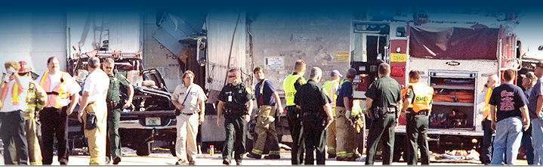
Response
  Response includes all activities to save lives and reduce damage from the event including:
  Emergency assistance to victims.
  Restoring critical infrastructure ( utilities, roadways, etc.)
  Ensuring continuity of critical services.

Slide 15
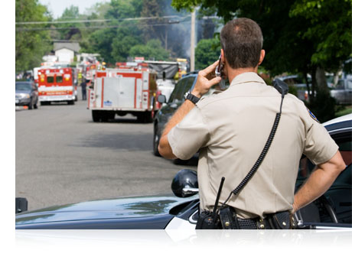
Response
  Immediate Rapid Assessment
  Determine immediate lifesaving, life sustaining needs, and immediate hazards.
  Takes place in first few hours.
  Enables responders to:
  Prioritize response activities.
  Allocate scarce resources.
  Request additional assistance and mutual aid.

Slide 16
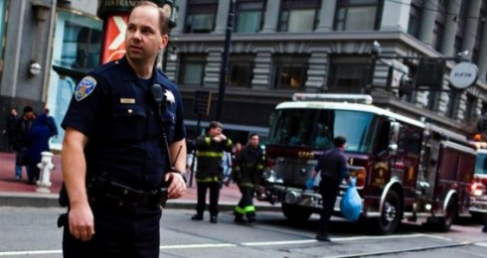
Response
  Challenges…
  Recognizing the scope and magnitude of the event as early as possible.
  Remember all disasters are local.
  No one is coming in to take over.
  Show up...in person.
  Who’s in charge?
  Who's in charge of what?

Slide 17

Response
  Rapid Assessment information:
  Lifesaving such as evacuation, search & rescue.
  Status of critical infrastructure:
    Utilities, transportation, communications systems, fuel and water supplies.
  Status of critical facilities:
    Public safety facilities, medical, water & sewage treatment.
  Risk of damage from imminent hazards:
    Dams, levees, hazmat facilities, severe weather
  Displaced residents.

Slide 18
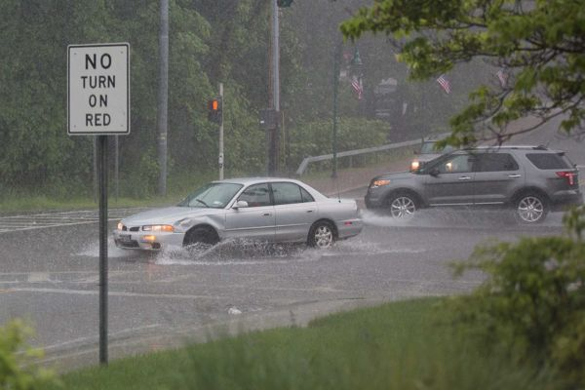
Response
  Rapid Assessment information
    Cascading events:
    Flash flood disrupts electricity…
    Causing traffic accident…
    Accident involves hazardous material spill…
    Neighborhood must be evacuated…
    Local water supply is contaminated by haz-mat spill.

Slide 19
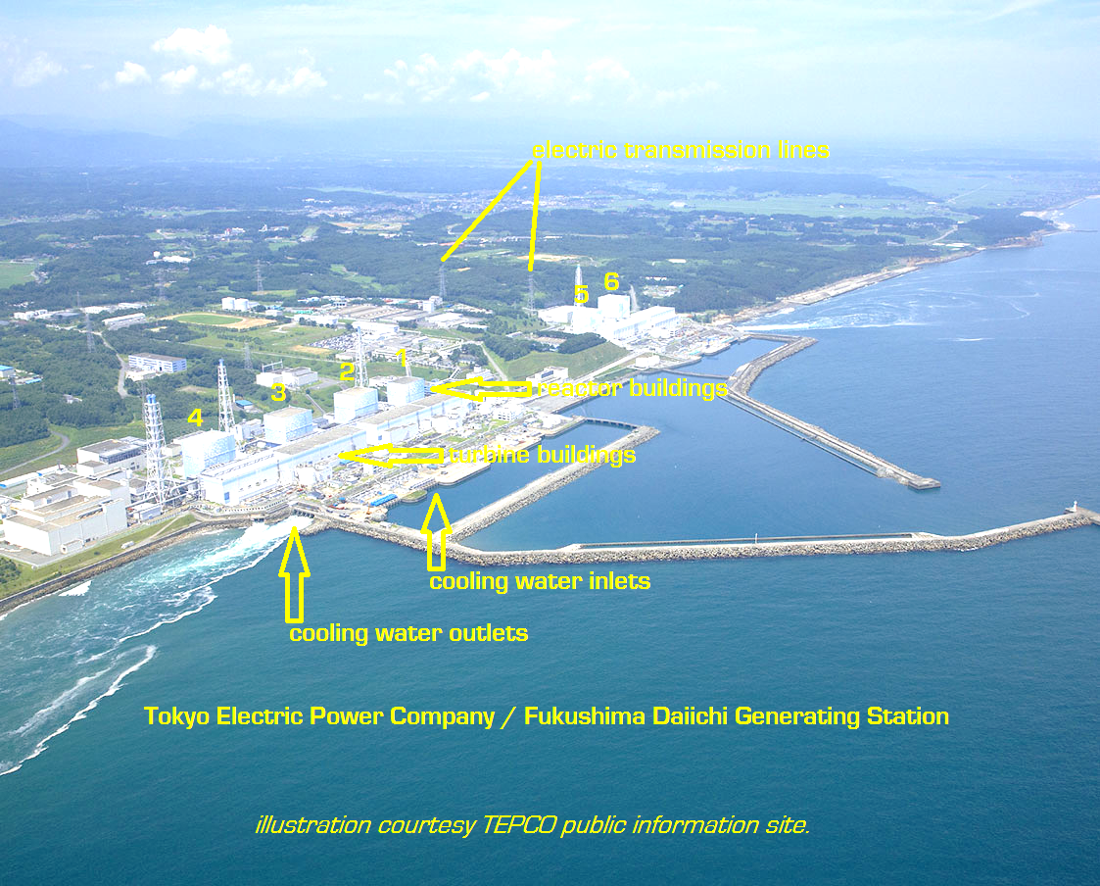
March 11, 2011
14:46 9.0 Earthquake
System scrams reactors 1,2,3
4,5,6 down for maintenance
Plant off power grid with
backup generator's functioning
15:27 First Tsunami strikes
15:30 Cooling condenser fails #1 reactor
15:46 2nd Tsunami overtops seawall
disables backup generators
16:00 Nuclear emergency declared
18:00 Falling water levels in reactor #1 core

Slide 20

Recovery
Recovery begins when the event occurs
Goal: Restoring normalcy to the community and your agency.
Long-term: includes restoring economic activity and community rebuilding .
Local, state and federal economic assistance.
Mental health.

Slide 21
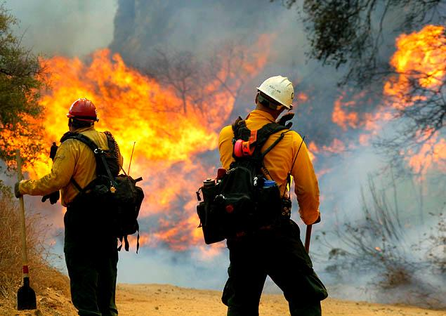

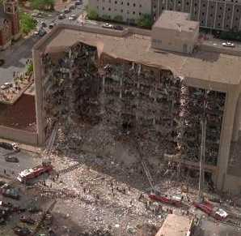
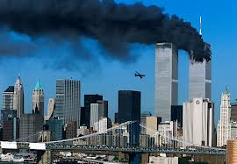
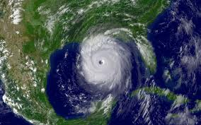
History of Incident Command System (ICS)
Military Reorganization Act of 1920
  Post WW1 due to cumbersome bureaucratic structure
Early 1970s – Firescope
  Multi-state wildfire incident management
Never received much attention in other public safety disciplines.
  1993 WTC attack
  1995 Murrah Building, Oklahoma City
  2001 9/11
  2005 Katrina

Slide 22
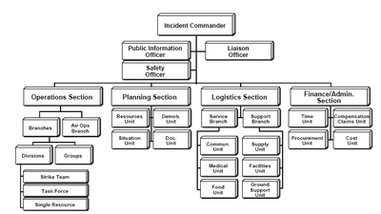
ICS
Is part of a process, not a standalone system
Is not how we normally do business
  an organizational framework to assist with the management of a critical incident or event
It is a team effort intended to delegate specific responsibilities to key people to be coordinated by an incident commander
It is scalable-the structure grows with the complexity of the incident
Must be flexible-individuals may wear different and perhaps multiple hats
Must practiced to be applied under the stress of a real event
Is a preplanning tool-can be used before a scheduled event takes place
Designed for first responders
Mutual aid requires training

Slide 23
Incident Management Team
Incident
Commander
Public Information
Officer
Incident Management Team = Command and General Staff Members
Liaison
Officer
Safety
Officer
Operations
Section
Planning
Section
Logistics
Section
Finance/Admin
Section
Incident Management Team
Notes:
Present the following key points:
An Incident Management Team (IMT) is an incident command organization made up of the Command and General Staff members and other appropriate personnel in an ICS organization.
The level of training and experience of the IMT members, coupled with the identified formal response requirements and responsibilities of the IMT, are factors in determining the “type,” or level, of IMT.
IMTs may be designated prior to an incident in order to train and exercise together to become qualified to response to different types of incidents.
Provide examples of IMTs from within the participants’ agency or jurisdiction.

Slide 24
Who Does What?
Finance/Admin: Monitors costs related to the incident. Provides overall fiscal guidance.
Command: Overall responsibility for the incident. Sets objectives.
Incident
Commander
Operations
Section
Planning
Section
Logistics
Section
Finance/Admin
Section
Operations: Develops the tactical organization and directs all resources to carry out the Incident Action Plan.
Planning: Develops the Incident Action Plan to accomplish the objectives.
Logistics: Provides resources and all other services needed to support the incident.
Notes:
Present the following key points:
The Incident Commander is responsible for establishing incident objectives.
The Operations Section Chief is responsible for managing all tactical operations at an incident. The Incident Action Plan provides the necessary guidance. The need to expand the Operations Section is generally dictated by the number of tactical resources involved and is influenced by span of control considerations.
The Planning Section Chief is responsible for providing planning services for the incident. Under the direction of the Planning Section Chief, the Planning Section collects situation and resources status information, evaluates it, and processes the information for use in developing action plans. Dissemination of information can be in the form of the Incident Action Plan, in formal briefings, or through map and status board displays.
The Logistics Section Chief provides all incident support needs with the exception of logistics support to air operations.
The Finance/Administration Section Chief is responsible for managing all financial aspects of an incident. Not all incidents will require a Finance/Administration Section. Only when the involved agencies have a specific need for finance services will the Section be activated.

Slide 25
Functional Responsibilities
Command
Operations
Planning
Logistics
Finance /Administration
In charge of all the stuff
Do stuff
Keep track of what stuff has been, is being done and may have to be done
Get stuff
Pay for all the stuff

Slide 26
Command Staff
The Incident Commander may designate a Command Staff who:
  Provide information, liaison, and safety services for the entire organization.
  Report directly to the Incident Commander.
Incident
Commander
Public Information
Officer
Liaison
Officer
Command
Staff
Safety
Officer
Notes:
Present the following key points:
The Command Staff is assigned to carry out staff functions needed to support the Incident Commander. These functions include interagency liaison, incident safety, and public information.
Incident Command comprises the Incident Commander and Command Staff. Command Staff positions are established to assign responsibility for key activities not specifically identified in the General Staff functional elements.
The Command Staff includes the following positions:
Public Information Officer
Advises the Incident Commander on information dissemination and media relations.
Obtains information from and provides information to the Planning Section.
Obtains information from and provides information to the community and media.
Liaison Officer
Assists the Incident Commander by serving as a point of contact for agency representatives who are helping to support the operation.
Provides briefings to and answers questions from supporting agencies.
Safety Officer
Advises the Incident Commander on issues regarding incident safety.
Works with the Operations Section to ensure the safety of field personnel.
Ask the participants to identify types of incidents where it would be critical to assign a Safety Officer.
The Command Staff may include additional positions as required and assigned by the Incident Commander.

Slide 27
Example: Expanding Incident (1 of 3)
Scenario: On a chilly autumn day, a parent calls 911 to report a missing
7-year-old child in a wooded area adjacent to a coastal area.
Incident
Commander
Public Information
Officer
Safety
Officer
Liaison
Officer
EMS
Group
Search
Group
Investigation
Group
Initially, the Incident Commander manages the General Staff resources.
Notes:
Tell the participants to review the scenario described on the visual.
Scenario
At 4:30 p.m. on a chilly autumn day, a parent calls 911 to report a missing 7-year-old child. The child was outside playing and may have wandered off into a vast wooded area adjacent to a coastal area.
The initial ICS organization includes:
Safety Officer to ensure the well-being of all responders and volunteers.
Liaison Officer to coordinate the different response groups.
Public Information Officer to handle the increasing numbers of media arriving at the scene.
The Incident Command is managing the following tactical resources: Emergency Medical Services Group, Search Group, and Investigation Group. The Search Group and Investigation Group each have a Supervisor who reports to the Incident Commander.
Instructor Note: Use the next series of visuals to demonstrate how the ICS organizational structure expands and contracts through the life-cycle of an incident. If time permits, ask the participants to identify the Executive’s/Senior Official’s priorities and actions.

Slide 28
Example: Expanding Incident (2 of 3)
Scenario: As additional resource personnel arrive, the Incident Commander assigns an Operations Section Chief to maintain span of control.
Incident
Commander
Public Information
Officer
Safety
Officer
Liaison
Officer
Operations
Section
Staging
Area
As the incident expands, an Operations Section Chief is assigned.
EMS
Group
Search
Group
Investigation
Group
Canine
Strike Team
Volunteer
Searchers
Notes:
Explain that as resources continue to expand, the Incident Commander assigns an Operations Section Chief to manage the tactical operations and resources.
The initial Operations Section includes a Staging Area where available resources wait for assignments. Three Groups have been established: the EMS Group, Search Group, and Investigation Group. Within the Search Group, resources are being organized into teams.
If the incident expands more, then the Operations Section Chief may add:
Divisions, which are used to divide an incident geographically.
Branches, which are used when the number of Divisions or Groups exceeds the span of control, and which can be either geographical or functional.

Slide 29
Example: Expanding Incident (3 of 3)
Scenario: With hundreds of responders and volunteers arriving, there is a need for on-scene support of the planning and logistics functions.
The Incident Commander adds a Planning Section Chief and Logistics Section Chief.
Incident
Commander
Public Information
Officer
Safety
Officer
Liaison
Officer
Operations
Section
Planning
Section
Logistics
Section
Remember . . . Not all Sections need to be activated!
Notes:
Tell the participants to review the next part of the scenario. After the first hour, the Incident Commander establishes the following additional Sections to support the operation:
Planning Section to develop the Incident Action Plan and track the status of resources on the scene.
Logistics Section to provide resources and all other services needed to support the incident. The Logistics Section will order needed resources, set up communications systems, and establish feeding areas for searchers.
Note that in this incident the Finance and Administration functions were not needed. Sections are only established if needed.
Explain that although there are no hard-and-fast rules, it is important to remember that:
Only functions/positions that are necessary are filled.
Each activated element must have a person in charge.
An effective span of control must be maintained.

Slide 30
Chain of Command
Incident
Commander
Orderly Line of Authority
Public Information
Officer
Command Staff
Liaison
Officer
Safety
Officer
General
Staff
Operations
Section Chief
Planning
Section Chief
Logistics
Section Chief
Finance/Admin
Section Chief
Branch
Director
Branch
Director
Service
Branch Director
Support
Branch Director

Slide 31
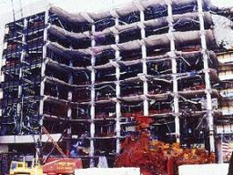
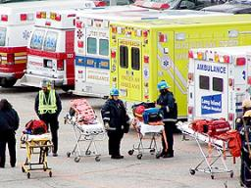
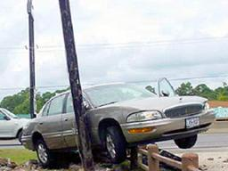
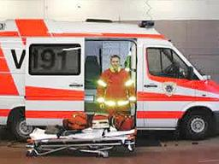
Incident Complexity and Resource Needs
Incident Complexity
Resource Needs
ICS Structure
Complexity
Resources
Notes:
Refer the participants to the visual. Note that as demonstrated in the lost child scenario, as complexity increases, resources must increase, requiring an organization with additional levels of supervision.

Slide 32
Complexity Analysis Factors
In your agency or jurisdiction, what factors may affect the complexity of an incident?
Notes:
Ask the participants to identify the factors that may affect the complexity of an incident. If not mentioned, add any of the following relevant factors:
Impacts to life, property, and the economy
Community and responder safety
Potential hazardous materials
Weather and other environmental influences
Likelihood of cascading events (events that trigger other events)
Potential crime scene (including terrorism)
Political sensitivity, external influences, and media relations
Area involved, jurisdictional boundaries
Availability of resources

Slide 33
Complexity Analysis Factors
  Impacts to life, property, and the economy.
  Community and responder safety.
  Potential hazardous materials .
  Weather and other environmental influences.
  Likelihood of cascading events (events that trigger other events).
  Potential crime scene (including terrorism)
  Political sensitivity, external influences, and media relations.
  Area involved, jurisdictional boundaries.
  Availability of resources.

Slide 34
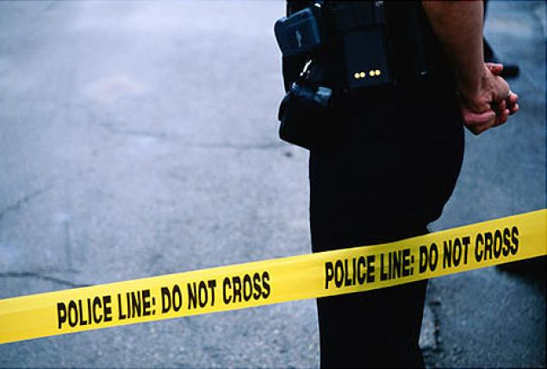
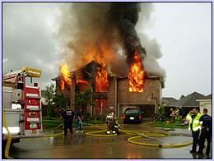
Overall Priorities
Initial decisions and
objectives are established
based on the following
priorities:
#1: Life Safety
#2: Incident Stabilization
#3: Property/Environmental
Conservation
Notes:
Explain that the Incident Commander develops incident objectives—the statement of what is to be accomplished on the incident. Not all incident objectives have the same importance.
Incident objectives can be prioritized using the following simple “LIP” mnemonic:
Life Safety: Objectives that deal with immediate threats to the safety of the public and responders are the first priority.
Incident Stabilization: Objectives that contain the incident to keep it from expanding and objectives that control the incident to eliminate or mitigate the cause are the second priority.
Property/Environmental Conservation: Objectives that deal with issues of protecting public and private property and the environment are the third priority.
Explain that incident objectives are not necessarily completed in sequence determined by priority. It may be necessary to complete an objective related to incident stabilization before a life safety objective can be completed. Using the LIP mnemonic helps prioritize incident objectives. This device can also be used to prioritize multiple incidents, with those incidents with significant life safety issues being given a higher priority than those with lesser or no life safety issues.
Ask the participants for examples of each type of priority. Present examples based on your experience.

Slide 35
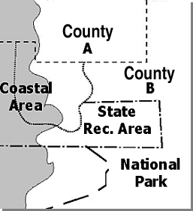
Coordination Among Agencies
A wide-area search is underway for a child who is missing. The search covers the areas shown on the map.
What agencies may be part of the incident?
What activities are being coordinated?
Notes:
Review the following scenario: A wide-area search is underway for a child who is missing. The search covers the areas shown on the map.
Next ask the following discussion questions:
What agencies may be part of the MACS?
Possible Answers
National Park Service
County A - Fire and Rescue
County B - Sheriff's Search and Rescue
U.S. Coast Guard
State Parks Department
State National Guard Volunteer Groups
Private landowners and/or industry
What activities are being coordinated?
Possible Answers
Prioritizing resource requests
Providing logistics support and tracking
Coordinating media

Slide 36
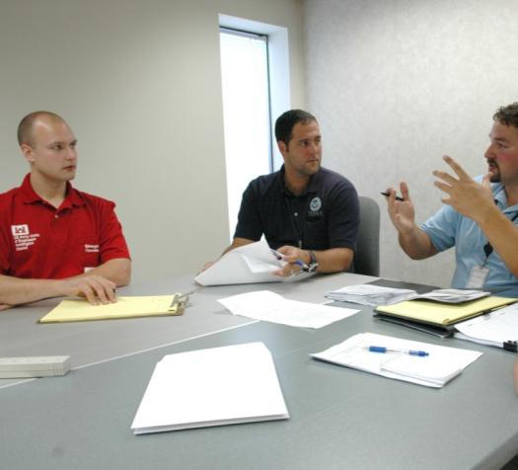
Incident Management Assessment
Assessment is an important leadership responsibility. Assessment methods include:
  Corrective action report/
  after-action review.
  Post-incident analysis.
  Debriefing.
  Post-incident critique.
  Mitigation plans.
Notes:
Present the following key points:
Management is an important leadership responsibility.
Assessments should be conducted after a major activity in order to allow employees and leaders to discover what happened and why.
Common assessment methods include:
Corrective action report/after-action review.
Post-incident analysis.
Debriefing.
Post-incident critique.
Mitigation plans.

Slide 37
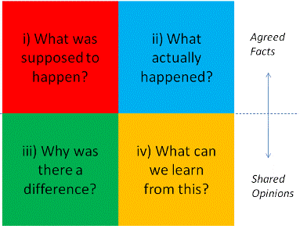
After-Action Review
Ensure an after-action review is conducted and answers the following questions:
  What did we set out to do?
  What actually happened?
  Why did it happen?
  What are we going to do different next time?
  Are there lessons learned that should be shared?
  What follow-up is needed?
Notes:
Present the following key points:
An after-action review (AAR) is conducted to identify what was supposed to happen, what actually happened, why it happened, and how to sustain strengths and improve weaknesses. An assessment may be conducted at the end of an incident or at the completion of a major milestone.
The AAR should not be conducted as a critique. An effective AAR:
Is not judgmental or punitive, and does not judge success or failure.
Focuses on why things happened.
Encourages participants to identify and capture important lessons.
An AAR may be either formal or informal.
Formal AAR. A formal AAR is more structured, requires planning, and takes longer to conduct. A neutral third party should facilitate a formal AAR.
Informal AAR. Informal AARs are less structured, require much less preparation and planning, and can be conducted anywhere, anytime, for any incident, by anyone.
Whether formal or informal, an AAR should seek answers to the following questions:
What did we set out to do?
What actually happened?
Why did it happen?
What are we going to do different next time?
Are there lessons learned that should be shared?
What followup is needed?

Slide 38

Training, Credentialing, and Exercising
  Do you have sufficient qualified personnel to assume ICS Command and General Staff positions?
  Can you verify that personnel meet established professional standards for:
    Training?
    Experience?
    Performance?
  When was the last tabletop or functional exercise that practiced command and coordination functions? Did you participate in that exercise?
Notes:
Explain that Executives/Senior Officials must ensure that incident responders are well trained and qualified. Tell them they must consider:
If there are sufficient qualified personnel to assume ICS Command and General Staff positions.
Explain that Executives/Senior Officials are responsible for ensuring that a qualified Incident Commander has been designated for the incident. Some agencies and jurisdictions maintain a roster of qualified Incident Commanders based on the complexity of the incident.
Ask the participants to identify the qualities of an effective Incident Commander. If not mentioned by the participants, add any of the following qualities: skilled/experienced in directing tactical response operations; command presence; understanding of ICS; proven management record; strong decisionmaker; calm but quick-thinking; good communication skills; adaptability and flexibility; realistic about personal limitations; and political awareness.
If they can verify that personnel meet established professional standards for:
Training.
Experience.
Performance.
When the last tabletop or functional exercise was conducted to practice command and coordination functions. Note that Executives/Senior Officials should participate in these exercises.

Slide 39
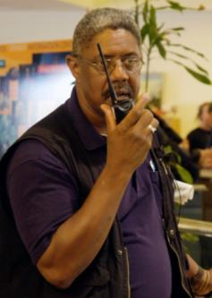
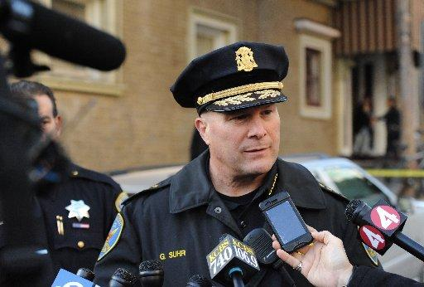
Leadership
Most importantly, Executives/Senior Officials provide leadership.
Leadership means . . .
  Motivating and supporting trained
  on-scene responders so that they can accomplish difficult tasks under dangerous, stressful circumstances.
  Instilling confidence in the public that the incident is being managed effectively.
Notes:
Summarize by noting that Executives/Senior Officials have an important leadership role. This leadership role means providing motivation and support to allow the trained, on-scene responders to accomplish difficult tasks under dangerous, stressful circumstances. It also means instilling confidence in the public that the incident is being managed effectively.
Refer the participants to the handout at the end of the briefing package.
Ask the participants if they have any questions. After addressing any questions, thank the group for their participation.

Slide 40
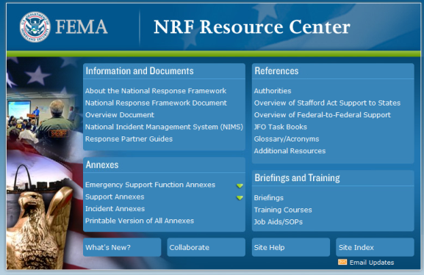
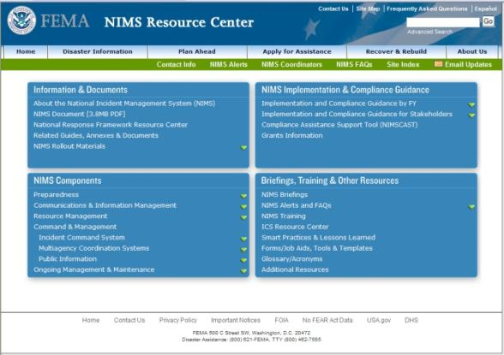
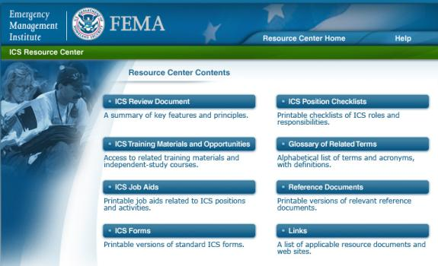
Additional Resources-Federal
  NRF Resource Center: www.fema.gov/nrf
  NIMS Resource Center: www.fema.gov/nims
  ICS Resource Center: ww.training.fema.gov/emiweb/IS/ICSResource
Notes:
Explain that additional resources are available including job aids, checklists, and additional training.
Visit the NRF Resource Center to gain access to:
National Response Framework information and documents.
References.
Briefings and training.
Visit the NIMS Resource Center to gain access to:
National Incident Management System information and documents.
References.
Briefings and training.
Visit the FEMA Emergency Management Institute (EMI)’s ICS Resource Center to gain access to:
Resources and tools.
Additional courses.

Slide 41

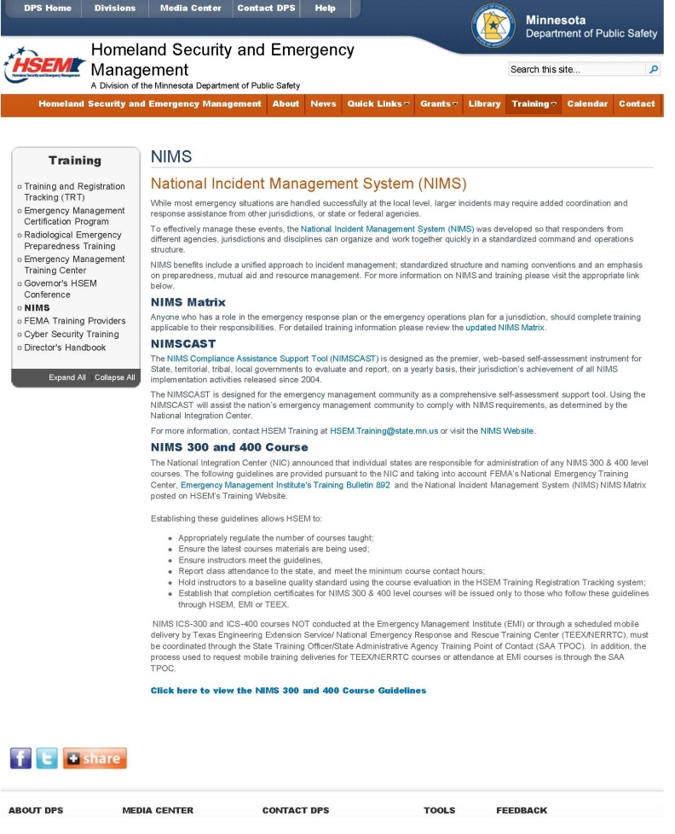
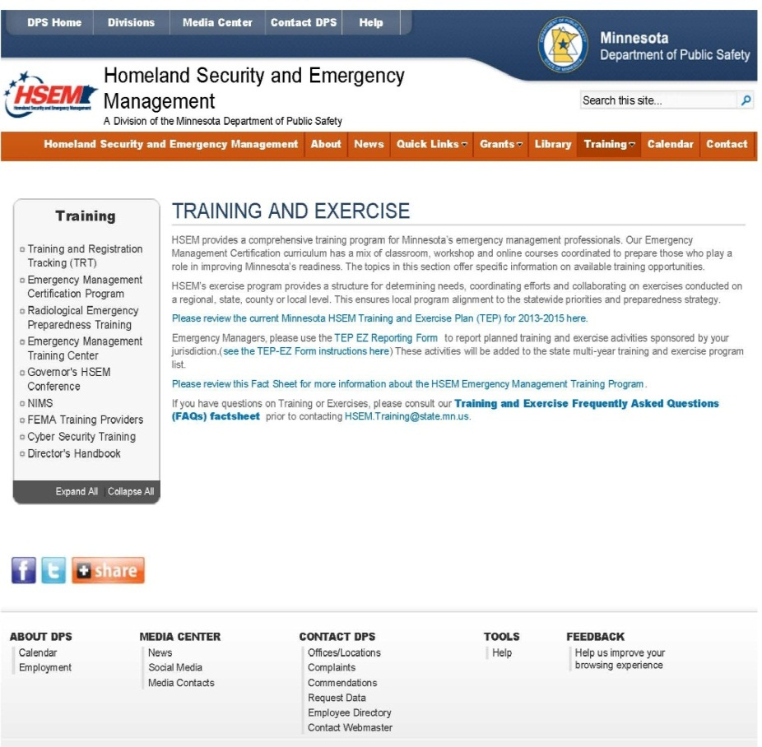
Additional Resources-State
  https://dps.mn.gov/divisions/hsem/Pages/default.aspx
  https://dps.mn.gov/divisions/hsem/training/Pages/nims.aspx
  https://dps.mn.gov/divisions/hsem/training/Pages/default.aspx
Notes:
Explain that additional resources are available including job aids, checklists, and additional training.
Visit the NRF Resource Center to gain access to:
National Response Framework information and documents.
References.
Briefings and training.
Visit the NIMS Resource Center to gain access to:
National Incident Management System information and documents.
References.
Briefings and training.
Visit the FEMA Emergency Management Institute (EMI)’s ICS Resource Center to gain access to:
Resources and tools.
Additional courses.

Slide 42


Questions?
Wade R. Setter
Superintendent
Minnesota BCA
651-793-1020
wade.setter@state.mn.us

Slide 43
Sources
California State University, Sacramento. (2004, March). Multi-Hazard Emergency Preparedness Plan. Retrieved June 20, 2013, from California State University Public Safety/University Police: http://www.csus.edu/aba/police/Documents/mhp/mhp_exec_guide.pdf
Chandler, B., & Setter, W. (2009, September 1). Hostile Action in a School Tabletop Exercise PowerPoint. St. Paul, MN, United States.
FEMA. (2012, October 24). EMI Field Delivery Course Materials for States, Tribal Nations and Territories. Retrieved June 20, 2013, from FEMA Emergency Management Institute: http://training.fema.gov/gstate/downloadMats.asp?course=G402%20-%20ICS-402%20-%20Incident%20Command%20System%20(ICS)%20Overview%20for%20Executives%20and%20Senior%20Officials

Slide 44
Hostile Action in a School
Tabletop Exercise

Slide 45
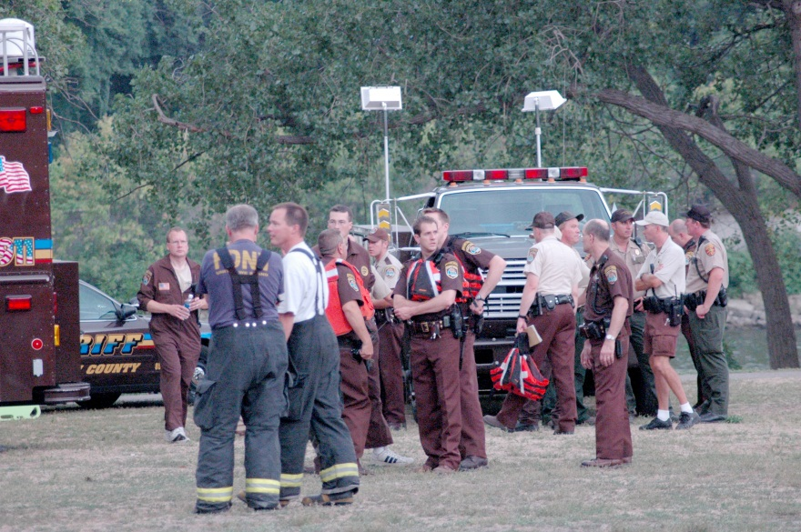
Goal of this exercise
To provide local, state and federal public safety partners with an opportunity to work through a simulated scenario together, develop solutions to problems posed as part of that scenario and define your agencies role.
Notes:
45

Slide 46
Rules of Engagement
Respond based on your knowledge of current plans and capabilities.
Assume cooperation and support from other responders and agencies.
There are NO wrong answers.
The scenario is what it is.
Notes:
46

Slide 47

Conditions
“Today”
Current weather conditions and forecast.
Your agency is at full shift staffing.
You have the authority to make decisions for your agency.

Slide 48
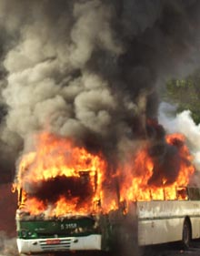
911 call at 1312 hours;
Reporting a transit bus has exploded and people are injured in front of the Smart High School.

Slide 49
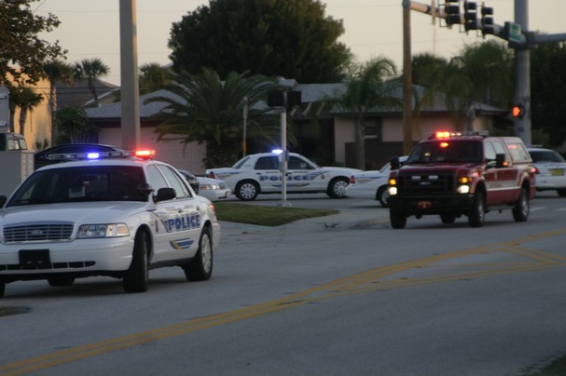
Response
One local police squad
Two transit police squads
Two fire companies
Two ALS ambulances

Slide 50

911 calls at 1316 hours;
Multiple cell phone calls from people stating they are inside the Smart High School; at least two people have been shot, multiple shots are being heard and there is a fire in the administration office.
Three callers reporting at least one armed individual is holding a 9th grade class in the second floor chemistry lab
Due to budget cuts, there is no SRO.

Slide 51
Response
Six local one officer police squads
Three county deputy sheriff’s with squads
One DNR Conservation Officer
Two more fire companies
Three ALS ambulances sent to stage one block away

Slide 52

Scene size-up
First arriving officer reports a fully involved bus on fire in front of the school, dozens of screaming students and adults running from the school, light gray smoke is coming from a first floor window.
Several people tell the officer conflicting reports of one to three people shooting students, numerous people down in the hallways and hostages in the second floor chemistry lab.

Slide 53
Concerns so far?
Directions for incoming units?
Priorities – plan of action?

Slide 54

Smart School Complex
Second floor area
NORTH
Athletic Field
Bus fire
School House Road

Slide 55
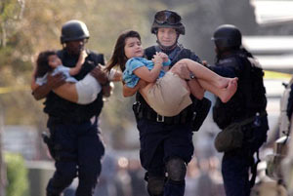
All first assigned law enforcement officers have arrived as well as three federal officers (USSS/FBI/ATF) who were working nearby (13 total).
The fire companies and ambulances are all in staging.
You can hear multiple gun shots coming from inside the school, there is a no smoke showing in the main hallway of the school.

Slide 56
You dispatcher states that national news is reporting a public school in Milwaukee has a hostile action occurring with at least one armed individual taking hostages and a vehicle burning in the school parking lot.

Slide 57
Smart School Complex
Second floor area
NORTH
Athletic Field
Bus fire
School House Road

Slide 58

What are your immediate Priorities?
What is your plan of action?
Who can give you the best information on the facility?
Who else should you invite to the party?

Slide 59
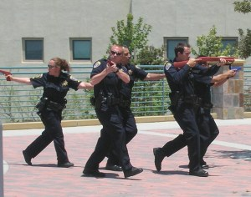
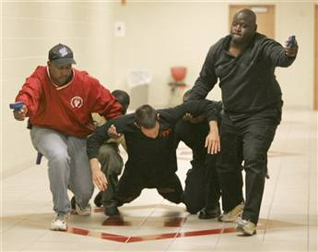
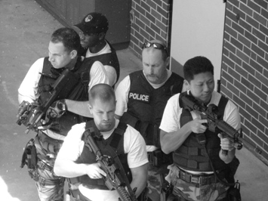
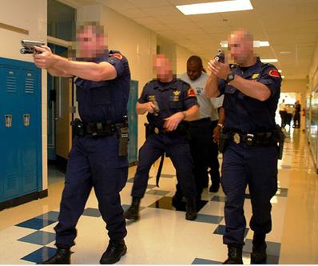
Coordinated response with ad-hoc teams

Slide 60
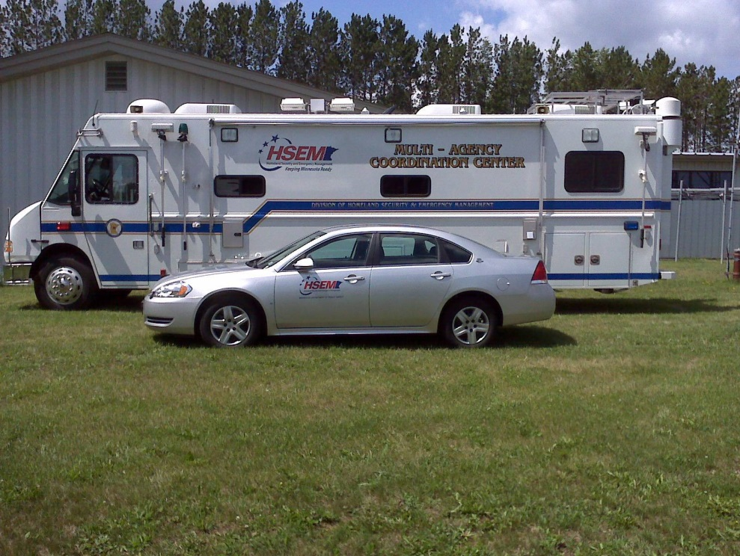
Where should you establish a command post?
Should you activate your EOC??
How long could this take?
What should your long
term strategy be?

Slide 61

Questions?
Concerns?
Ideas!
Notes:
61

