Slide 1
Today’s New Supervisor
Helping you NAVIGATE…

Slide 2
Kyle Leibel Lino Lakes Public Safety Dept.
BS in LE from Metropolitan State University
Police Officer since 1996
Patrol sergeant in 2005 (same time I began to lose my hair)
FTO/PTO training supervisor 2009
Northwestern University Center for Public Safety School of Staff and Command, 2008
Sentenced to administrative and investigation sergeant in 2012
Firefighter I, II, HazMat Operations Certification in 2015

Slide 3
Some thoughts before we start…
I’m trusting you…
Confidentiality is key to this discussion and to your success as a supervisor
What’s with you?

Slide 4
Goals of this discussion
Provide some insight into your new role
Real tools and tactics
Talk perception vs. reality and put customer service in proper context

Slide 5
Foundation
Need to understand theory, but this discussion is going to focus on concrete action items

Slide 6
Here are your stripes…
Traits of a good supervisor and common themes of a bad one.
Most supervisors receive no training before promotion and often wait until well after they begin their new role
Not one style fits all
You may not always have all the answers

Slide 7
Here are your stripes…
Your promotion is not a reward for a single action or assignment
SRO? DARE? INV?
Not everyone around you will agree with your promotion
Start by respecting the position, then earn respect as a supervisor

Slide 8
Still one of the guys… ?
No matter how you might feel about your promotion, people WILL start treating you different, so you might as well do it right
Innocent questions are now interrogation

Slide 9
Dirty Secret #1
What made you a good officer, is not necessarily what is going to make you a good leader.

Slide 10
What got you here, won’t necessarily keep you here…
Supervisors: Made vs. born
You have to BELIEVE that you need to acquire new skills and seek out learning opportunities in order to be a good supervisor…
You will never know too much

Slide 11
The do’s and don’ts
General guidelines and tips to consider
We will discuss some behavior goals of effective supervisors and some tactics to achieve those goals

Slide 12
Do...
Be patient
Know and respect the chain of command
Do the work you’re assigned and do it well, assign others to work and direct your shift… Be the conductor
Know the rules and follow them
Don’t allow deviation from rules just because you used to do them…

Slide 13
Do…
Respect confidential information
Stay technically proficient, but leave work for top performing patrol
Recognize good work
Hold people accountable… fairly and consistently

Slide 14
Do…
Be in constant learning mode
Take responsibility for your shift
Where do you spend most of your shift?
Apologize when you’re wrong

Slide 15
Don’t…
Think you can take off your stripes
“Hey Sgt, can I talk to you as a friend, not as a sgt?”
Think they aren’t watching/listening
Simple things keep them from wondering… Do you hide behind your computer?
Be a gossip

Slide 16
Don’t…
Wear your stripes on your ego, leave them on your sleeves
Coach, mentor, trainer, evaluator…
Pole vault over mouse poo
Forget that your officers can hurt…

Slide 17
Dirty Secret #2
They know what you did as an officer and they don’t forget.
So how do you correct behavior of others that you engaged in as an officer?
Acknowledge, Explain, Move on…

Slide 18
“I don’t know, call the sergeant”
Three types of call:
Your officers will call you looking for…
1. Assurance
- Foster independence and confidence
2. Guidance
- Don’t be to quick to “give” the answer
3. An accomplice
- Ask questions of them

Slide 19
Holding people accountable
New and experienced supervisors dread correcting behavior
Avoid Email (it’s the devil)
- Sleep on your emails
How people receive your message has to do with their outlook and your delivery…
- Is their reaction reflexive or reflective?

Slide 20
Reactions to criticism
When faced with work stress or criticism, people generally fall into one of two camps, Reflexive or Reflective

Slide 21
Reflexive…
How most people react when immediately faced with stress or criticism - defensive
Two types of reflexive people, those who blame others for their stress and those who blame themselves.
Blame others:
- I suffer because you/they/this place sucks
- Results in hostility, frustration and anger if uncorrected
- They avoid those they blame or attack reputation

Slide 22
Reflexive… Two types of reflexive people, those who blame others for their stress and those who blame themselves.
Blame Others:
Blame Self:
I suffer because you/they/this place sucks.
Results in hostility, frustration, and anger if left uncorrected
They avoid those they blame and attack reputation
I suffer because I suck
Employee can become depressed and withdrawn
“8 and skate” – just enough to get by and stay off the radar
Decreased productivity, avoids new tasks/challenges

Slide 23
How do you react?
Think of the last time a supervisor corrected you. How did you react?
Ever been corrected by one of your officers?
Supervisor maturity is how fast you can move beyond reflexive to reflective
What are your issues?
TIP: “That’s interesting, can you tell me more about that?”

Slide 24
Corrective Action
Format for correcting behavior or when giving negative feedback:
Start with a question
Address the real issue without catastrophizing
Past (existing rules)
present (issue at hand)
future (expectations)

Slide 25
Start with a question
Did you…? Can you tell me about…? Is there a reason…?
Make sure your delivery is not sarcastic or condescending
The purpose of the question is not to incriminate, but to ensure you know the proper context of the action or behavior

Slide 26
Past, Present, Future
Past: What EXACTLY is the issue you’re addressing?
Present: What was the resulting behavior/concern/issue?
Future: Consequences and the expected future behavior…

Slide 27
Positive Feedback
Each supervisor has a different bar
Establish your bar and be consistent
Consistency will avoid the appearance of favoritism

Slide 28
Importance of perception
You see yourself through a limited view that is usually based on your INTENTIONS. Others see you through your ACTIONS. Perception is reality.
Is there someone in your agency who you trust to tell it to you straight?

Slide 29
Be authentic - True to one’s own personality, spirit, or character
And NEVER compromise your integrity or ethics.

Slide 30
Does it matter how the people we work with perceive the way they’re treated?
Do internal interactions effect your officer’s public interactions?

Slide 31
Ten things they want from you
Autonomy and Independence
Clear expectations
Meaningful objectives
A true sense of purpose
Opportunities to provide significant input
A real sense of connection
Consistency
Private criticism
Public praise
A chance for a meaningful future

Slide 32
Don’t be afraid to turn down a promotion (including this one)
It’s not for everyone and don’t ever think the money will make it all worthwhile if you’re going to be miserable
It may not be “for you” at this point in your life/career…

Slide 33
Community Relations/Customer Service

Slide 34
Common barriers to customer service
Overworked staff
Underworked staff
Non-caring culture
Customer value has never been communicated
Poor accountability (videos, complaints)

Slide 35
Customer Service
Why should we care how our “customers” perceive me, my officers, my agency? (those f’ing Lino cops…)

Slide 36
“but I’m not paid to make people feel good, I’m paid to protect people and arrest bad guys.”
2014 UCR Case Clearance Rates:
Part I crimes (murder, rape, robbery, agg. Assault, human trafficking(comm. sex), human trafficking (involuntary servitude): STATEWIDE = 29%
Part II crimes (Everything Else): STATEWIDE = 61%

Slide 37
Importance of good customer service
Rapidly changing times… Changes in public perception toward law enforcement
Fairness and consistency in both positive praise as well as complaint processing from an objective perspective
Changes in technology:
Public expectation/CSI effect
Squad & body cameras
Budgets
Effectiveness – Public trust is a byproduct of good service. Build a great reputation that nobody can question.

Slide 38
“An injury is much sooner forgotten than an insult”
If you know how to set someone off, you also know how to calm them down

Slide 39
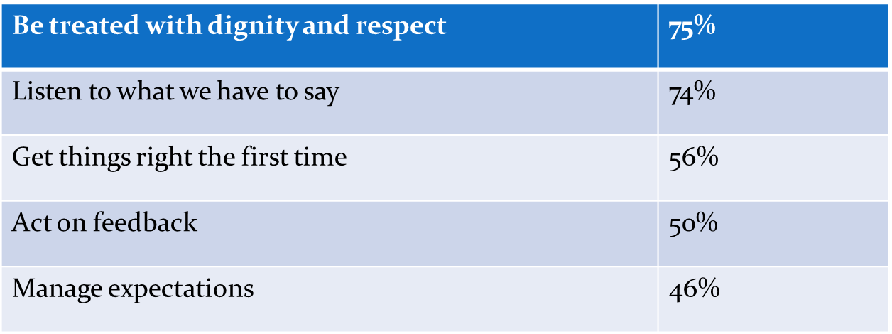
Now, the good news
Here is what our customers want:

Slide 40
What you can start doing today
Decide to give a shit
Let people have their say
Others don’t have to be wrong for you to be right. Conflict v. combat
Golden rule
Show your coworkers how customers should be treated

Slide 41
Thank you.
Good Luck…

